Slide 1
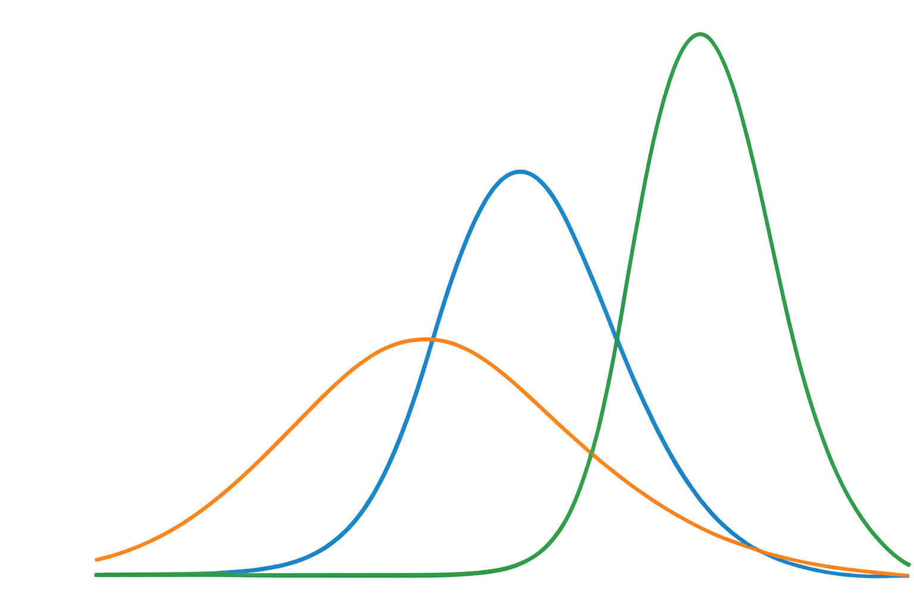
Gaussian Mixture Models (GMM)
Presented by Derek Malvin
6/7/2026
Notes:
Good morning everyone. My name is Derek and today I'll be presenting on Gaussian Mixture Models, which is a machine learning algorithm used for unsupervised clustering.

Slide 2
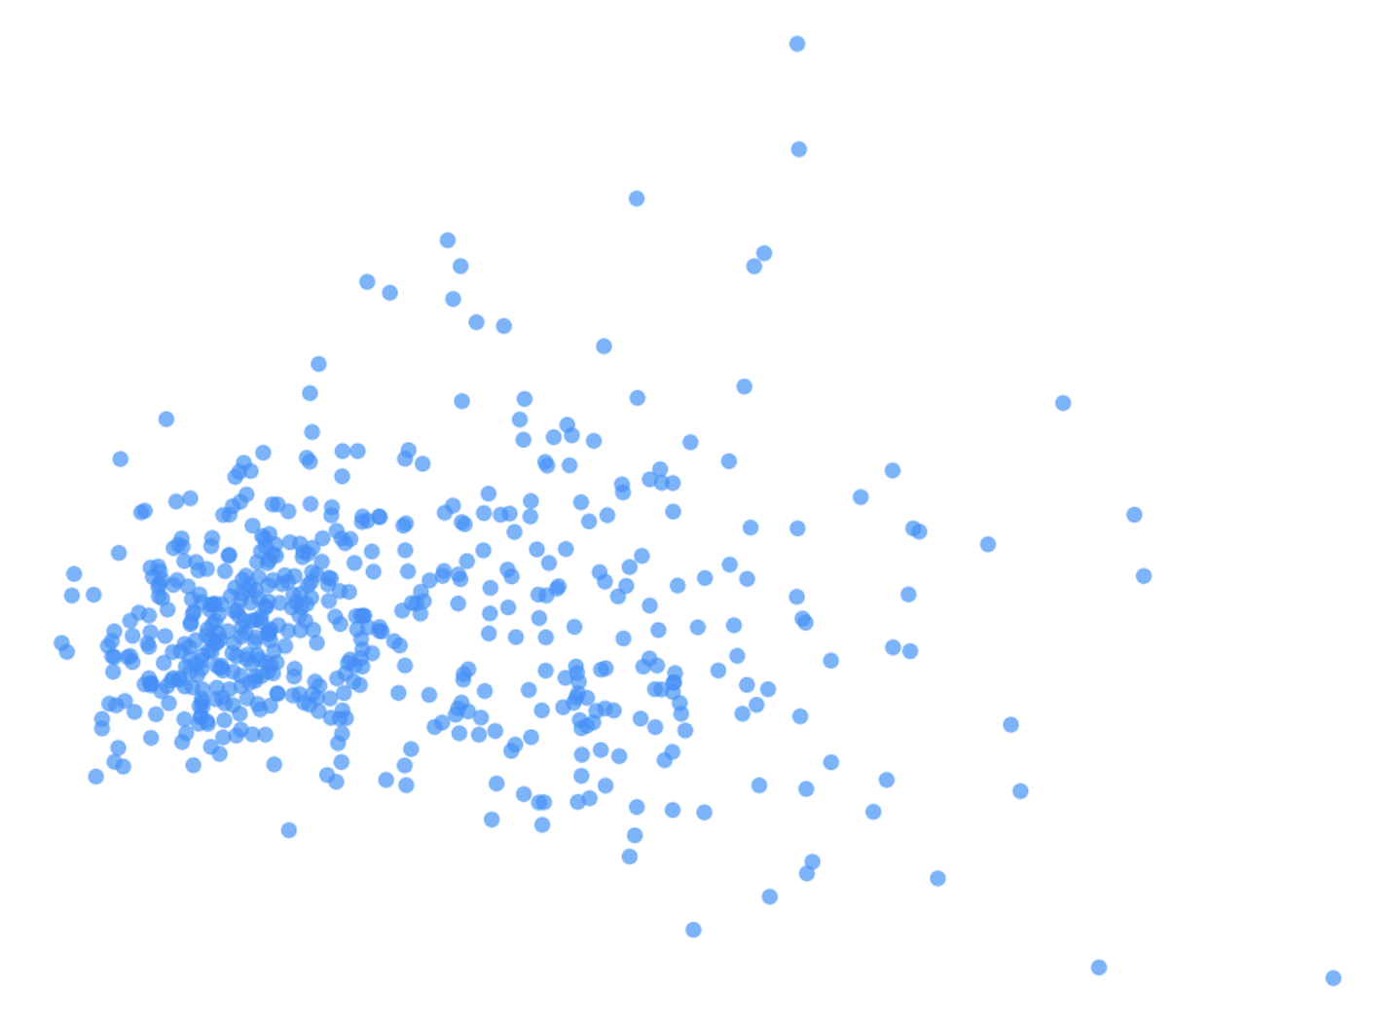
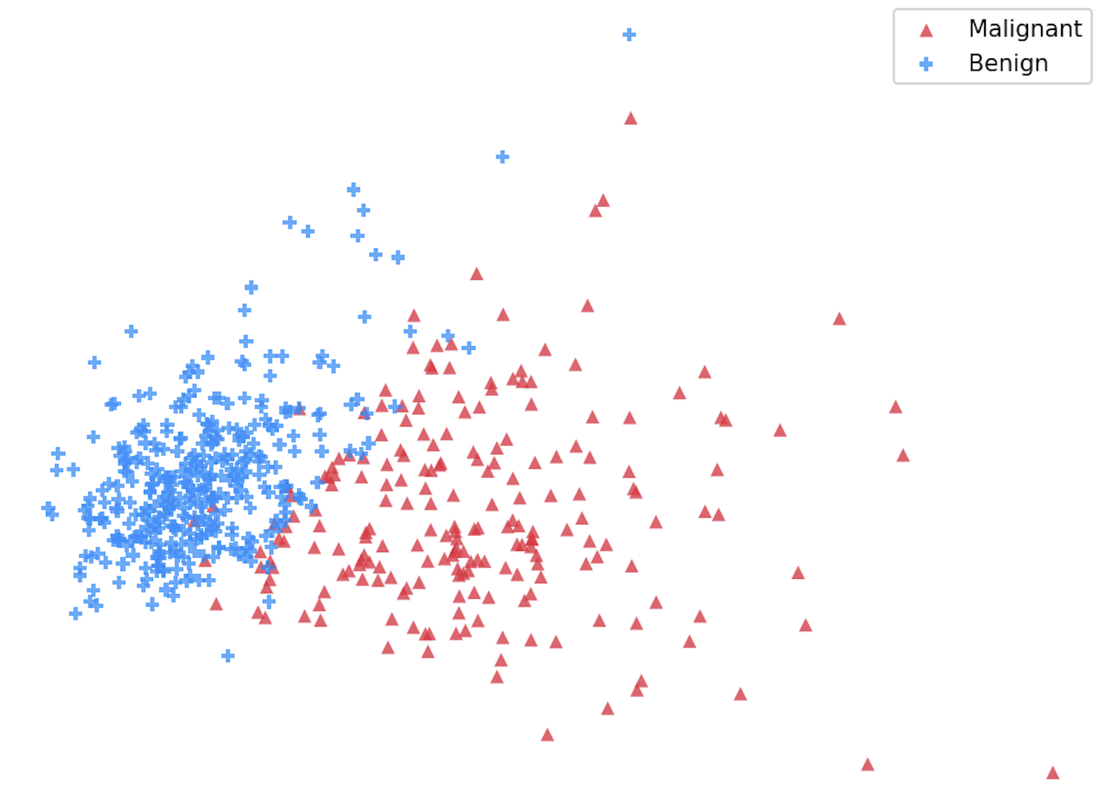
The Problem
Unlabeled data
Potentially multiple groups
How do we find them?
6/7/2026
Notes:
In many machine learning problems, we have data but no labels telling us which group each point belongs to. On the left is what the model actually sees , which is just a cloud of points with no information about what they represent.
But when we reveal the true labels on the right, we can see that two groups do exist and that they're just not perfectly separated. There's also some overlap in the middle which can make classification difficult.
So the question becomes: can an algorithm find these groups on its own, using only the measurements? And not just find them, but tell us how confident it is that each point belongs to each group. and that's exactly what a Gaussian Mixture Model is designed to do.

Slide 3
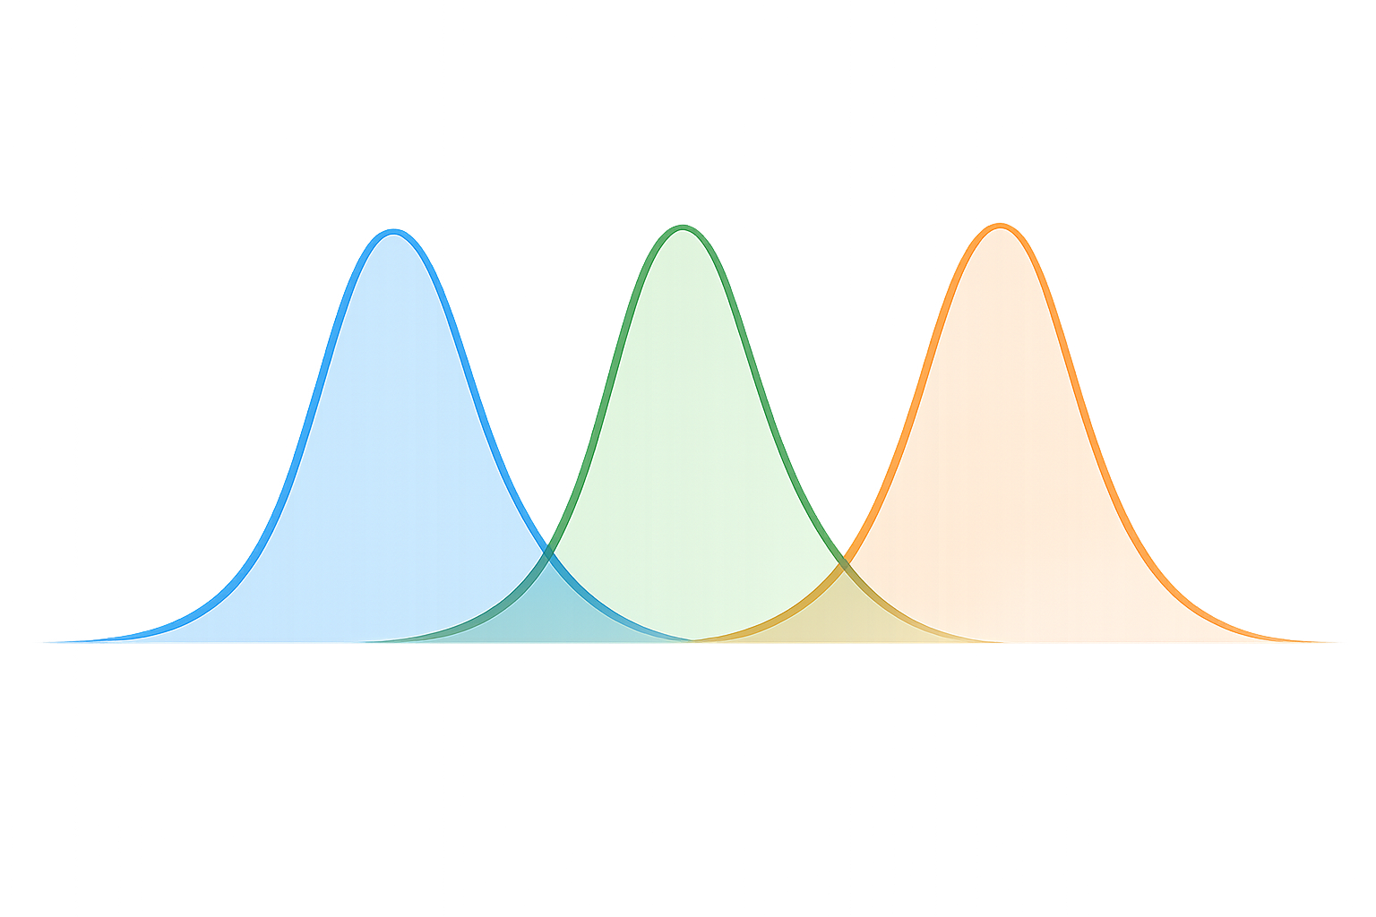
What is a GMM?
Cluster 1
Cluster 2
Cluster 3
Gaussian = Bell Curve/Normal Distribution
Data is modeled as a mixture of Gaussian distributions
Each distribution represents a cluster
Observations are assigned probabilities for each cluster
6/7/2026
Notes:
Now that we've seen the problem, let's talk about the solution.
A Gaussian Mixture Model, or GMM, assumes that our data is made up of multiple underlying groups. Each of those groups is represented by a Gaussian distribution, a bell-shaped curve with its own center and spread.
In this figure, each bell curve represents a different cluster. The overall dataset is modeled as a mixture of these distributions, which is where the name Gaussian Mixture Model comes from.
One important thing to notice is that the curves overlap. In real data, observations do not always belong clearly to one group or another. Unlike methods such as K-Means, GMM does not make a strict yes-or-no assignment. Instead, it estimates the probability that an observation belongs to each cluster.
For example, a point might have a 90% probability of belonging to one cluster and a 10% probability of belonging to another. This is known as soft clustering.
This probabilistic approach makes GMM especially useful when groups are not perfectly separated.
So the next question is: how does GMM mathematically represent these distributions and estimate those probabilities?

Slide 4
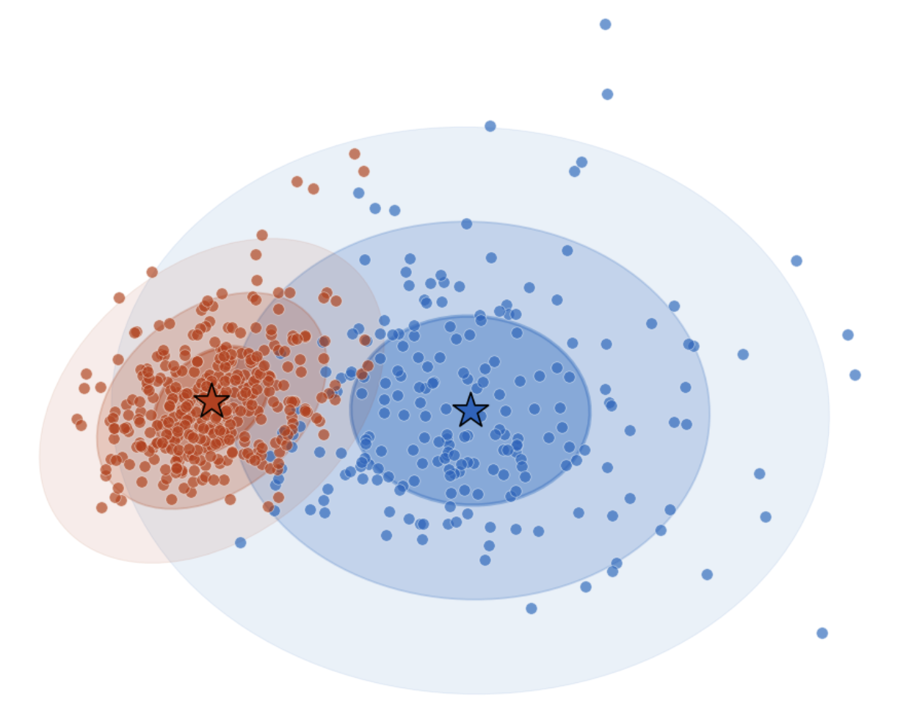
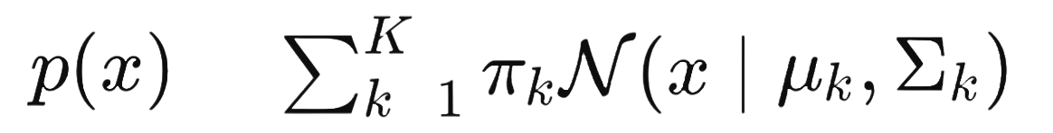
Math & Assumptions
μ = Cluster Center
Σ = Cluster Spread
=
=
Where:
x | Data Point
K | # of Clusters
k | Current Cluster
πₖ | Cluster Weight
μₖ | Cluster Center (Mean)
Σₖ | Cluster Spread/Shape
N | Normal Distribution
p(x) | Probability of Observing x
Expectation-Maximization Workflow
E-Step
M-Step
Repeat
Until
Clusters Stabilize
Estimate
Cluster
Probabilities
Update
Parameters
μ, Σ, π
Assumptions:
Clusters are Gaussian
# of clusters are specified
Observations are independent
Notes:
This is describing the same idea we saw on the previous slide.
At the end of the day, this is just asking a simple question for every single data point in our dataset, which bell curve explains it the best? We have K amount of bell curves, and each one gets a chance to claim that point. Some will say 'that point looks like it belongs to me' and some won't. We take all of those answers, weight them by how important each bell curve is, and add them up. The result is a probability and not a hard label that forces the point into one box, but a probability that tells us how confident we are about where it belongs.
Each cluster has a center, represented by μ, a spread and shape represented by Σ, and a weight represented by π.
(point at image)
Looking at the image here on the right side, The stars represent the cluster centers, while the ellipses show the spread of each Gaussian distribution.
(point at EM workflow)
Now looking below that image, we have the Expectation-Maximization Workflow. To estimate these parameters, GMM uses the Expectation-Maximization algorithm. The E-step estimates cluster probabilities, and the M-step updates the parameters. This process repeats until the clusters stabilize.
(point at assumptions)
The model assumes that clusters are approximately Gaussian, observations are independent, and that the number of clusters must be specified in advance and in our case we chose K=2 because we know there are two diagnostic groups.
Equation in plain English: For any data point, we compute a weighted sum across all K Gaussians. Each Gaussian has a center, a shape, and a weight. The equation gives us the overall probability of that data point under the mixture — and the cluster whose Gaussian gives the highest probability is where that point most likely belongs.​or any data point, we compute a weighted sum across all K Gaussians. Each Gaussian has a center, a shape, and a weight. The equation gives us the overall probability of that data point under the mixture — and the cluster whose Gaussian gives the highest probability is where that point most likely belongs.

Slide 5
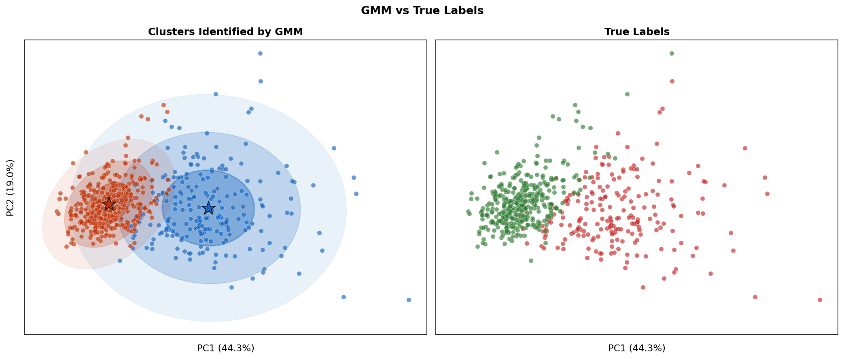
Dataset and Why GMM?
Benign
Malignant
Wisconsin Breast Cancer Dataset
Research Question
Metric | Value
Samples | 569
Features | 30
Benign | 357
Malignant | 212
Can GMM identify underlying groups corresponding to benign and malignant tumors?
6/7/2026
Notes:
To demonstrate GMM, I applied it to the Wisconsin Breast Cancer Dataset, which contains 569 tumor samples and 30 diagnostic features.
Although the benign and malignant labels are known, I treated this as an unsupervised learning problem and did not provide those labels to the model.
The figure on the left shows the clusters identified by GMM, while the figure on the right shows the actual diagnostic labels.
Notice that the two visualizations are very similar. This suggests that the dataset contains natural cluster structure that aligns well with the Gaussian assumptions of GMM, making the dataset a good candidate for Gaussian Mixture Modeling.
For this analysis, I specified K = 2 because the dataset contains two known diagnostic groups: benign and malignant tumors.
However, in real-world datasets, the true number of clusters is often unknown. In those cases, data scientists commonly use statistical criteria such as BIC (Bayesian Information Criterion) to help identify an appropriate value for K.

Slide 6
AUC 0.9742 Recall / Sensitivity Benign : 95.0% Malignant: 92.5%
• Strong agreement with known labels
• Only 34 of 569 samples differed
• Clusters closely matched benign and malignant diagnoses
Results
Notes:
Using a Gaussian Mixture Model with K equal to 2, the model achieved an AUC of 0.97 , A recall of 95% for Benign and 92.5% for Malignant. Overall, these results suggest that even without any labels during training, GMM successfully identified meaningful underlying structure that closely matches the true diagnostic groups.
Thank you

Slide 7
Thank You
Notes:
Question: How exactly does the EM work?
A:The E-step takes the current Gaussians and computes the probability that each data point belongs to each cluster. The M-step then takes those probabilities and updates all three parameters — the cluster centers, the shapes, and the mixing weights — to maximize how well the model explains the data. Then you repeat until nothing changes meaningfully.
Question: How does BIC determine the amount of K?
A: BIC keeps asking : does adding one more cluster explain the data meaningfully better, or are we just adding complexity for no real gain? When the answer becomes no, that's your K.
BIC fits a GMM for each value of K and scores each one by how well it fits the data minus a penalty for complexity. The K with the lowest score is where adding more clusters stops being worth it

